Slide 1
Scope Management Plan & Budget
IT463 - Group 3
Grad Bird Consultants
Eric Agyemang

Slide 2
Measurable Organizational Value (MOV)
Plan will implement incremental cost-effective changes during the next 4 years.
Plan increases IT security by migrating backup data to AWS
Plan increases networks speeds by upgrading current Wi-Fi routers to the newest and most powerful NetGear Wi-Fi routers. ( 3.6 Gbps combined throughput)
Ensure wired network reliability, 2 network switches will be replaced per year
Workstation desktops and laptops will be incrementally replaced
Ensure system reliability and accessibility, 3 servers will be replaced
The purpose of these cost-effective upgrades is to provide a highly beneficial system so that the city can continue to provide cost-effective services to the citizens of Mequon.

Slide 3
MOV
​ Organizational Impact ​ ​ ​ | Value ​ | Metric ​ | Time Frame ​
Customer ​ | Provide a better IT System to the city so the citizens can continue having low-cost services ​ | Fewer complaints from citizens. ​ 10% reduction ​ ​ Improving citizen satisfaction with Website ​ | ​ Annual Survey ​ 12 months ​ ​ ​ ​ Annual Survey ​ 12 months ​ ​ Project ​ 3-5 years ​

Slide 4
MOV
​ Organizational Impact ​ ​ ​ | Value ​ | Metric ​ | Time Frame ​
Financial | Effectively spending the city resources to improve or maintain the current IT system | Within Budget $110,000 And possible savings of 10% | Annual Budget Project 3-5 years

Slide 5
MOV
​ Organizational Impact ​ ​ ​ | Value ​ | Metric ​ | Time Frame ​
Operational | A more efficient IT system that is more available, reliable, secure and faster. | Reduced downtimes by 10%, improved performance (2x faster), and higher usability (increase in citizen usage by 10% and increased staff satisfaction) | Annual Survey

Slide 6
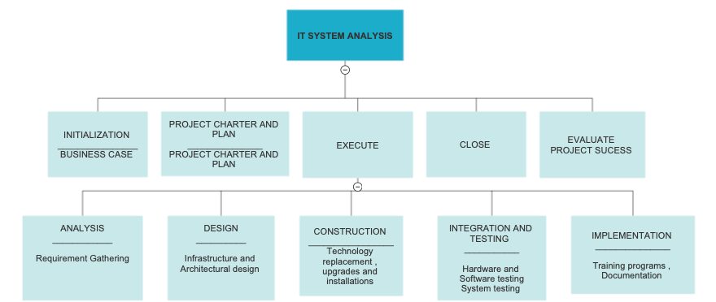
Deliverable Structure Chart

Slide 7
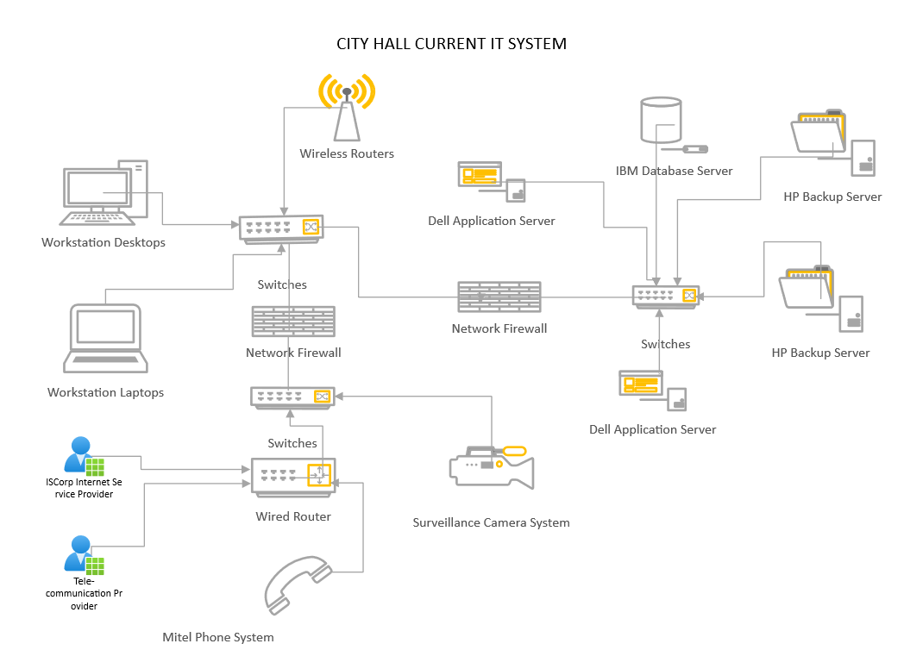
Current Network Diagram

Slide 8
Current Network Diagram
Public Safety Building – 2 Dell servers, without IBM database server
East Side Fire Station – 1Windows server, 1 Dell server, without IBM database server
Public Works – 1 Dell server, without IBM database server

Slide 9
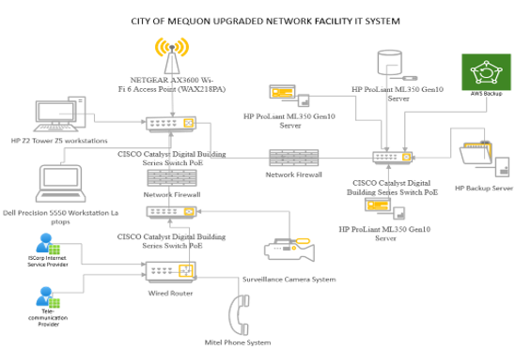
Upgraded Network Diagram

Slide 10
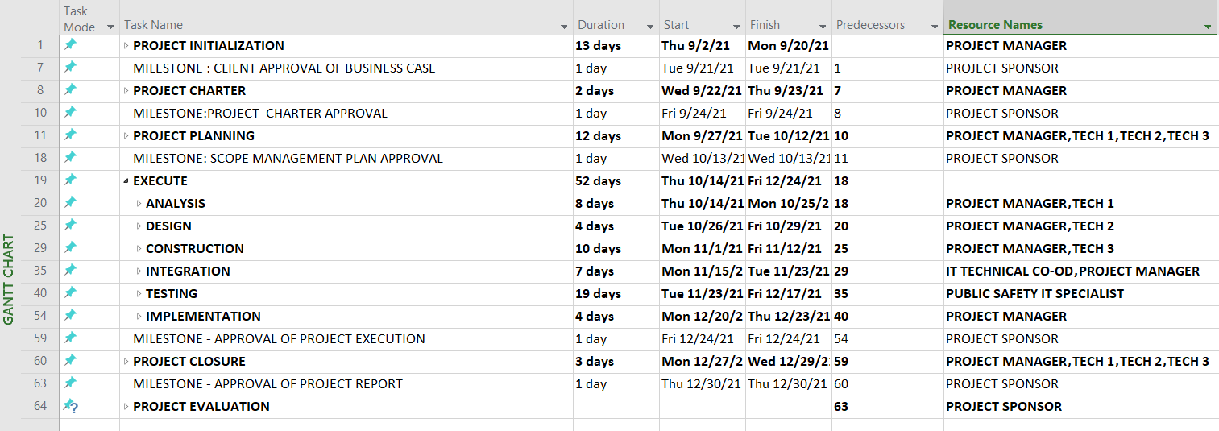
Work Breakdown Structure

Slide 11
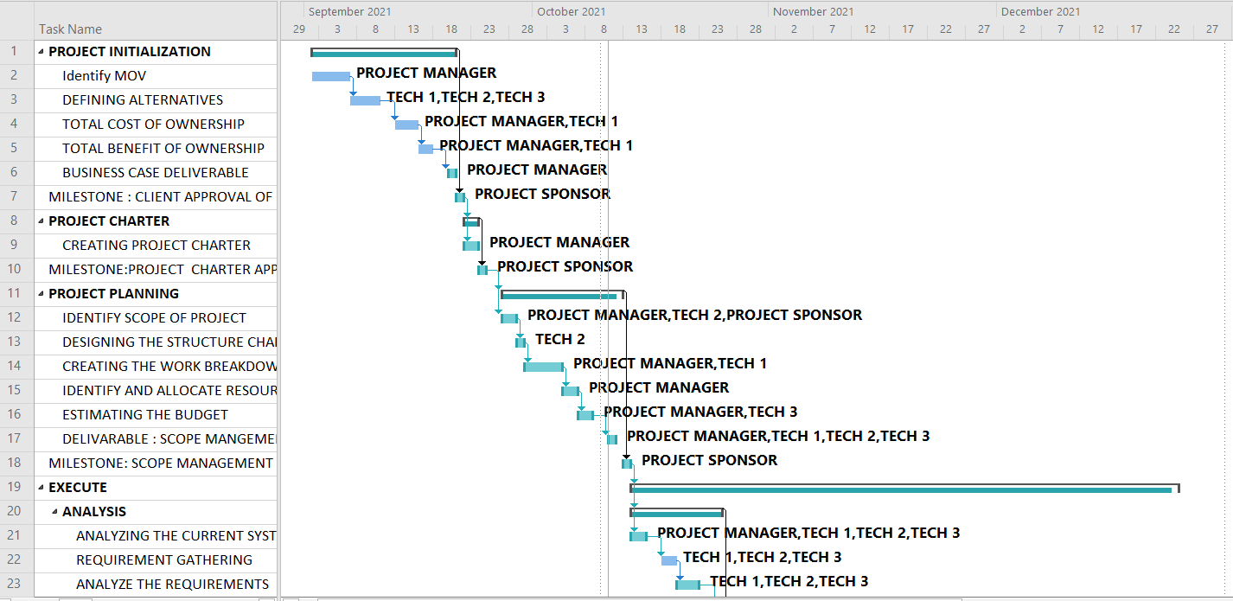
Gantt Chart

Slide 12
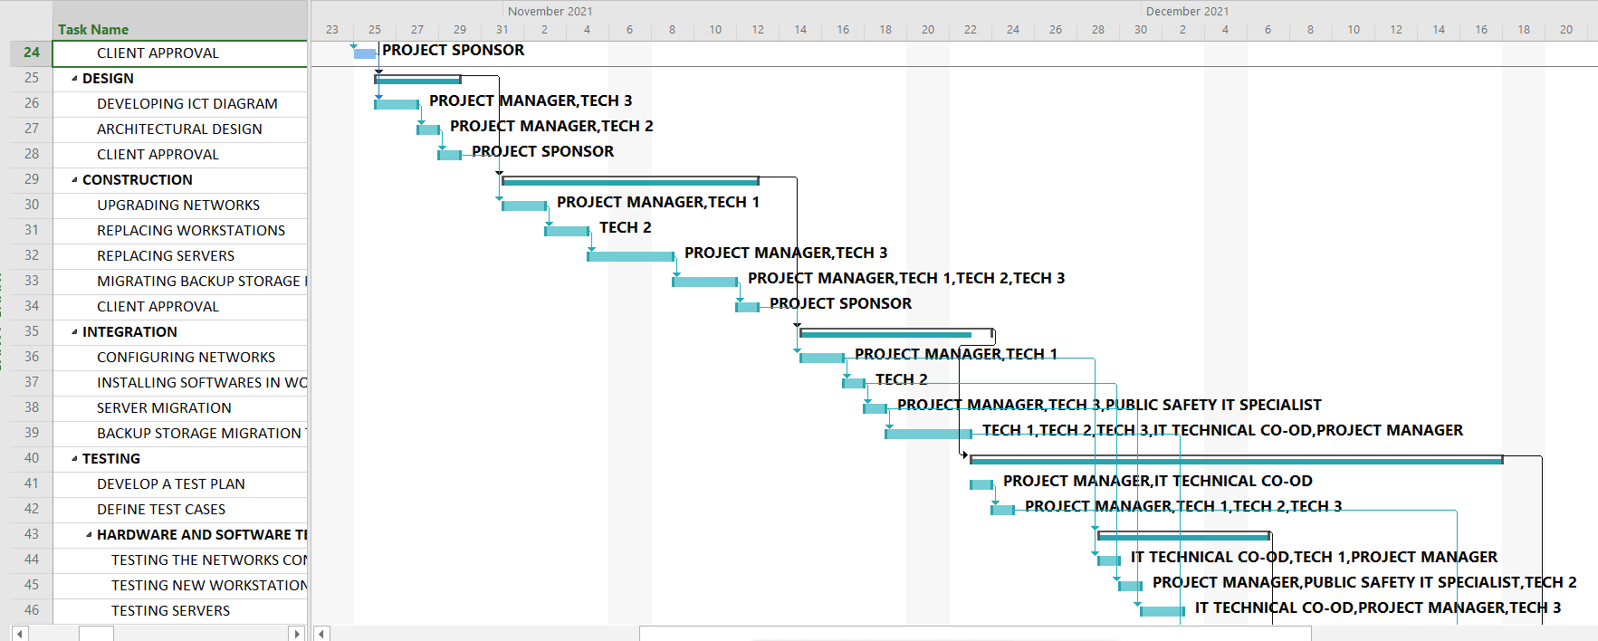
Gantt Chart
Gantt Chart

Slide 13
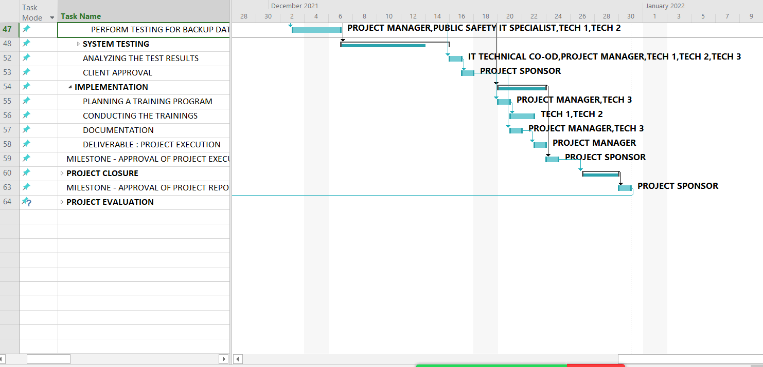
Gantt Chart

Slide 14
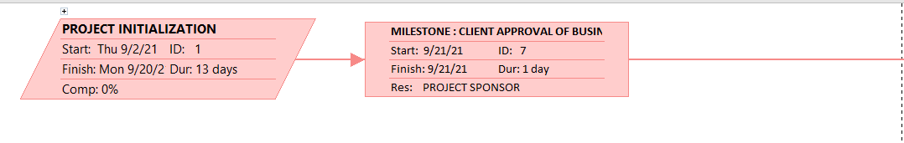
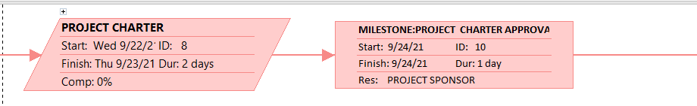
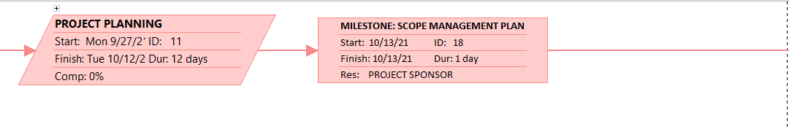
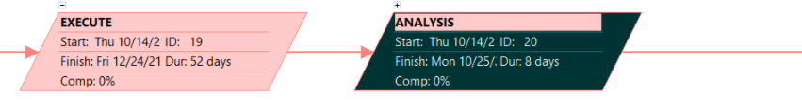
Critical Path

Slide 15
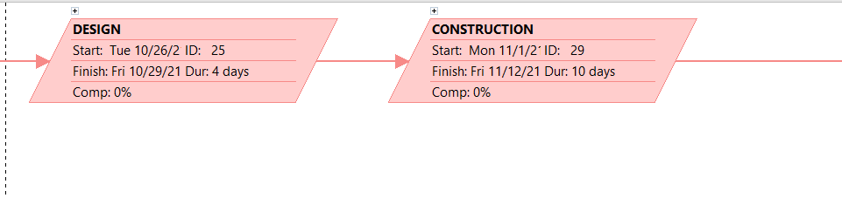
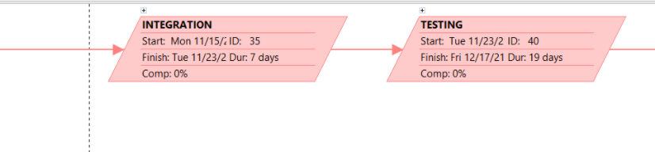
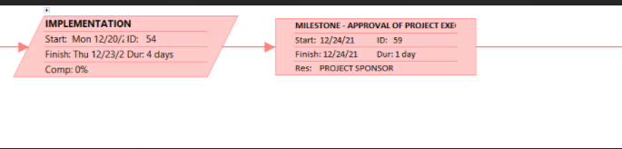
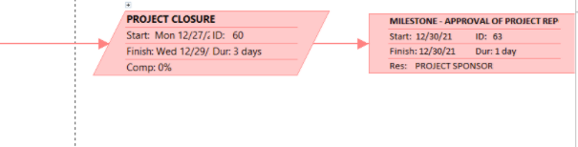
Cont.

Slide 16
Budget
BUDGET
 | Year 1 | Year 2 | Year 3 | Year 4
Funds | $110,000 | $110,000 | $110,000 | $110,000
IT Dept Salaries | ($6,720) | ($6,720) | ($6,720) | ($6,720)
Software | ($12,000) | ($12,000) | ($12,000) | ($12,000)
Office Supplies | ($2,000) | ($2,000) | ($2,000) | ($2,000)
Alt2 | ($61,597) | ($58,077) | ($65,197) | ($58,077)
Contingency | ($5,000) | ($5,000) | ($5,000) | ($5,000)
Total Surplus | $22,683 | $26,203 | $19,083 | $26,203

Slide 17
NPV
NET PRESENT VALUE (NPV)
Cash Flow Description | Year 0 | Year1 | Year 2 | Year 3 | Year 4 | TOTAL
Development cost | $(87,317)
Operation and Maintenance cost | $(1) | $(49,117) | $(51,520) | $(53,520) | $(55,520)
Discount factor 12 % | 1 | 0.8928 | 0.7971 | 0.7117 | 0.6355
Time adjusted costs (adjusted to present value) | $(87,317) | $(43,852) | $(41,067) | $(38,090) | $(35,283)
TOTAL PRESENT VALUE OF LIFETIME COSTS |  |  |  |  |  | $(245,609)
Benefits derived from operation of new system | 0 | $55,000 | $75,000 | $100,000 | $135,000
Discount factor 12 % | 1 | 0.8928 | 0.7971 | 0.7117 | 0.6355
Time adjusted benefits (adjusted to present value) | 0 | $49,104 | $59,783 | $71,170 | $85,793
TOTAL PRESENT VALUE OF LIFETIME BENEFIT |  |  |  |  |  | $265,850
NET PRESENT VALUE (NPV) |  |  |  |  |  | $20,241

Slide 18
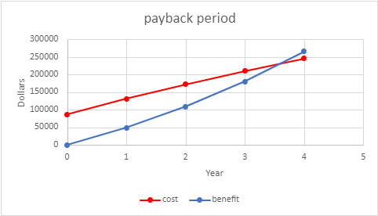
Return On Investment and Payback
RETURN ON INVESTMENT = | NPV/(TOTAL PRESENT VALUE OF LIFETIME COSTS) | 8.2411%

Slide 19
Thank You

